Slide 1


Ad_Hoc Insights Consumer Goods
1
Created by
RUTUJA THORVE

Slide 2
Objectives
2
AtliQ Hardware is one of the major computer hardware manufactures in india, with a strong presence in other nations too.
However, the management noticed that they do not get enough insights to make quick and smart data-informed decisions.
They want to expand their data analysts team by adding several junior data analysts.
This 10 ad_hoc requests are the part of SQL challenge which will help the Tony Sharma (Data Analytics Director) to evaluate both the tech and soft skills.

Slide 3
Company Details : AtliQ hardware is a computer hardware and accessory manufacturing.
3
Channels
Segment
Division
Direct
Retailer
Distributor
Accessories
Desktop
Networking
Notebook
Peripherals
Storage
P & A
PC
N & S

Slide 4
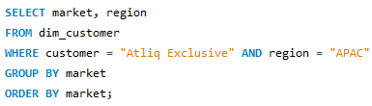
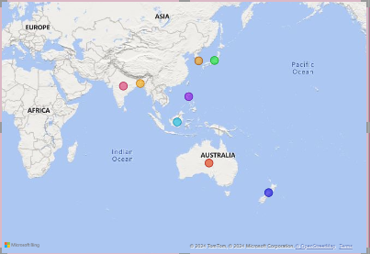
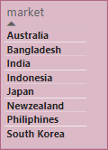
1. Provide the list of markets in which customer “AtliQ Exclusive" operates its business in the APAC region.
4

Slide 5

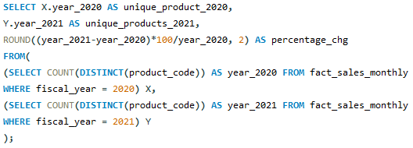
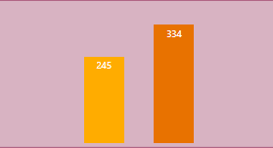
2. What is the percentage of unique product increase in 2021 vs. 2020?
5
+89
Demand and Production both increased in the year 2021.

Slide 6
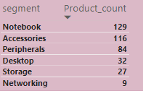

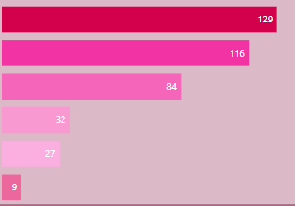
3. Provide a report with all the unique product counts for each segment and sort them in descending order of product counts.
6
Notebook, Accessories and Peripherals constitute 85% of total manufacturing product.

Slide 7
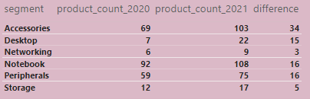
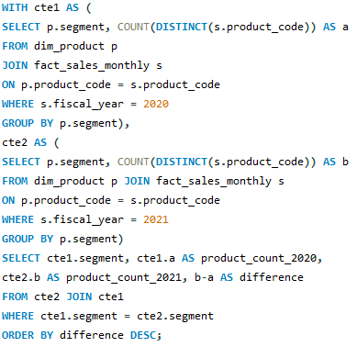
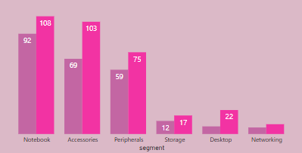
4. Which segment had the most increase in unique products in 2021 vs 2020?
7
Storage and Networking are showing slower production growth than other segments.

Slide 8

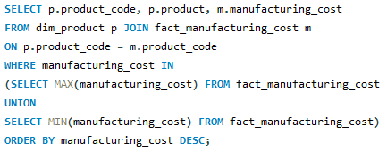
5. Get the products that have the highest and lowest manufacturing costs.
8
Personal Desktop : AQ HOME Alline 1 Gen 2 has the highest manufacturing cost.
Mouse : AQ Master wired x1 Ms has the lowest manufacturing cost.

Slide 9
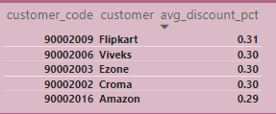
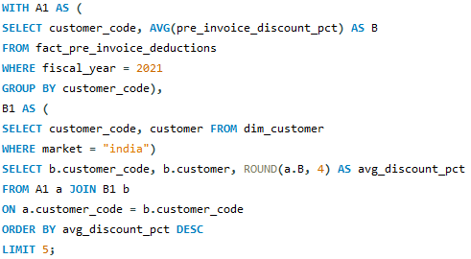
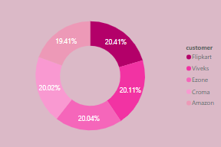
6. Generate a report which contains the top 5 customers who received an average high pre_invoice_discount_pct for the fiscal year 2021 and in the Indian market.
9
The Largest Avg pre invoice discount was given to Flipkart.

Slide 10
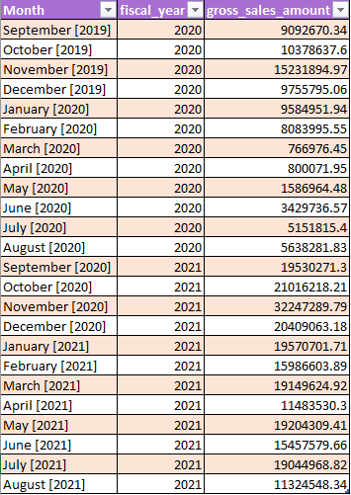
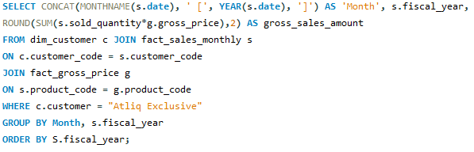
7. Get the complete report of the gross sales amount for the customer “AtliQ Exclusive” for each month. This analysis helps to get an idea of low and high-performing months and take strategic decisions.
10

Slide 11
11
The Lowest total gross sales for both the fiscal years is in March(2020).
The highest total gross sales for both the fiscal years is in November(2020)

Slide 12
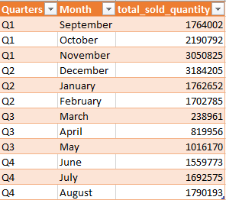
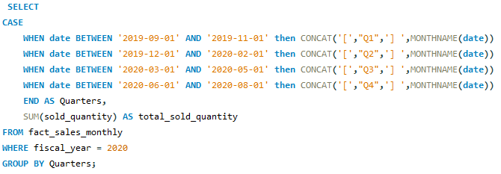
8. In which quarter of 2020, got the maximum total_sold_quantity?
12

Slide 13
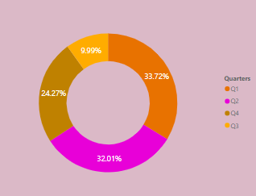
13
Quarter 1 of fiscal year 2020 having the most unit sold.
Quarter 3 of fiscal year 2020 showing the fewest unit sold.

Slide 14

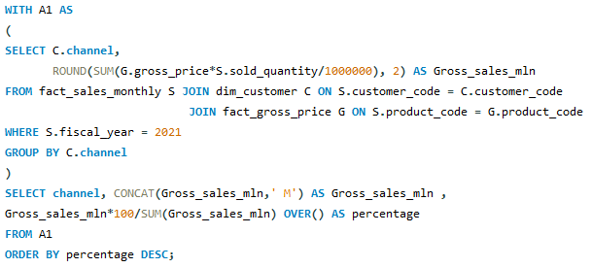
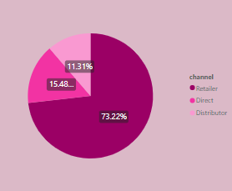
9. Which channel helped to bring more gross sales in the fiscal year 2021 and the percentage of contribution?
14
Channel Retailer helped bring maximum sales to the company.
Channel Distributor makes the least contribution.

Slide 15
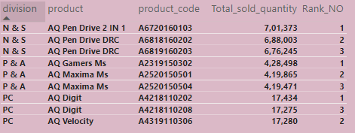
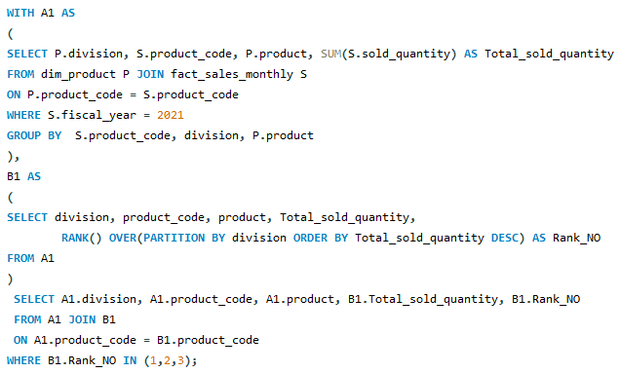
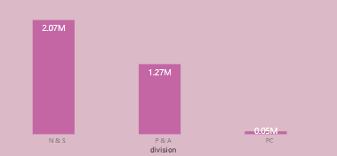
10. Get the top 3 products in each division that have a high total_sold_quantity in the fiscal_year 2021?
15

Slide 16
16
Thank you

